Slide 1

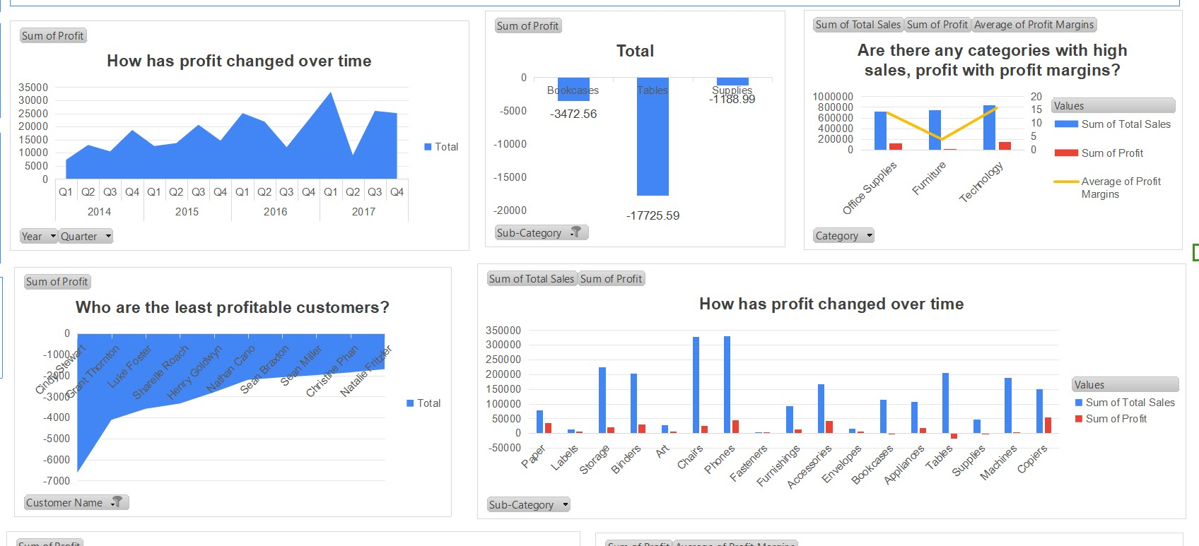

Slide 2
Insights
Profit has shown periodic peaks and troughs over Q4 2016 and Q1 2017, indicating fluctuations in performance during this period.
The Technology category exhibits high sales, substantial profit, and favorable profit margins, making it a key area of strength for the business.
In contrast, the Furniture category experiences moderate sales but has low profit margins, highlighting a need for strategic adjustments.
Office Supplies have high sales figures but low profitability, suggesting that pricing or cost management may require reevaluation.
Cindy Stewart has contributed to negative profits, with a loss of $6,626.37, indicating a potential area for improvement or reassessment.
Sub-categories such as Bookcases, Tables, and Supplies are significant loss drivers, collectively accounting for a total loss of $22,387.14.

Slide 3
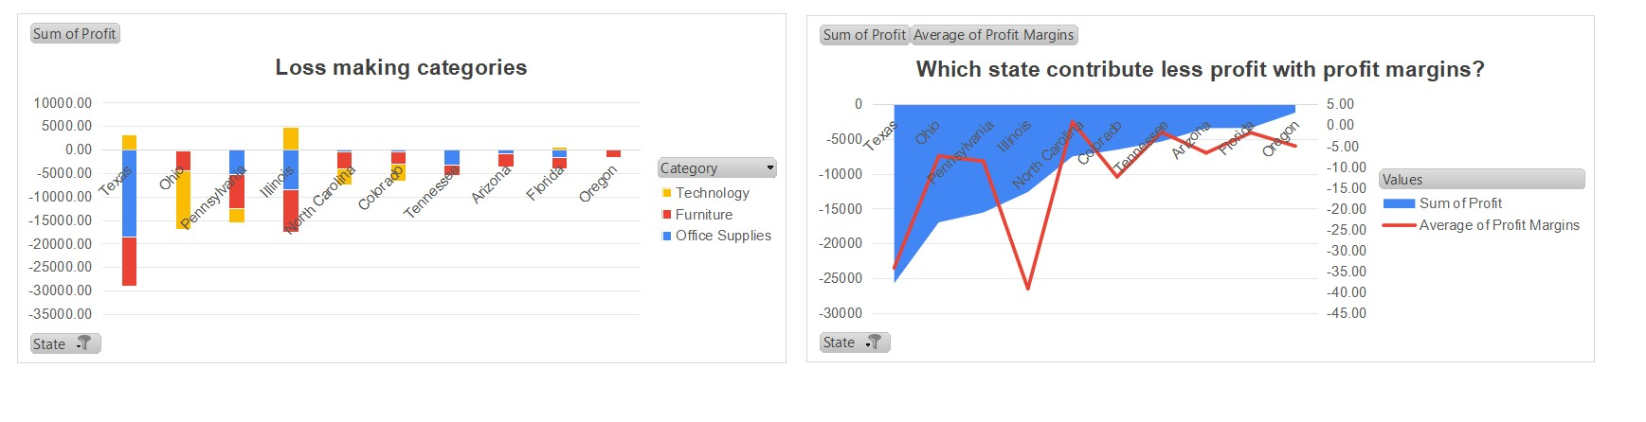

Slide 4
Insights
Texas shows the highest losses in the Furniture category, necessitating targeted strategies to address this issue.
Furniture contributes to losses across multiple states, including Texas, Pennsylvania, and North Carolina.
Office Supplies consistently show losses in most states, particularly in Ohio, Illinois, and Florida. This trend indicates a need for strategic marketing or product adjustments.
While Technology is generally profitable, it shows losses in states like Pennsylvania and Oregon, suggesting localized challenges that need to be addressed.
Illinois exhibits the sharpest decline in profit margins at 40%, highlighting an urgent need for intervention.
Furniture and Office Supplies are the primary loss drivers across states, indicating areas where operational improvements could yield better financial results.
Ohio experiences losses in both Technology and Furniture categories but gains in Office Supplies, suggesting potential for growth in that segment.

